Slide 1

Loops
TUIT
C++ Programming, Fall 2016
Lecture #5
II - part

Slide 2
TUIT
Roadmap
Last week we covered
Mathematical Functions, Characters, and Strings
This week we will learn
Which Loop to Use?
Nested Loops
Minimizing Numeric Errors
Case Studies
Keywords break and continue
Case Study: Checking Palindromes
Case Study: Displaying Prime Numbers

Slide 3
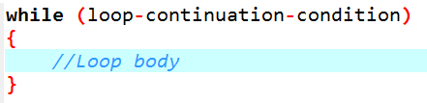

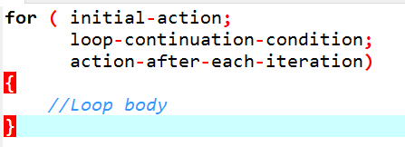
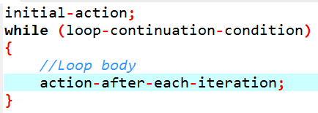
TUIT
Which Loop to Use?
You can use a for loop, a while loop, or a do-while loop, whichever is convenient.

Slide 4
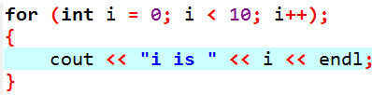

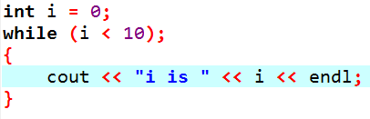
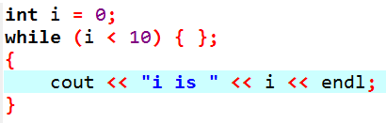
TUIT
Caution
Adding a semicolon at the end of the for clause before the loop body is a common error, as shown below.
Error
Empty Body

Slide 5
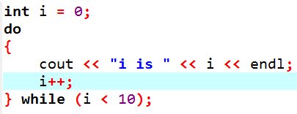
TUIT
Caution
In the case of the do-while loop, the semicolon is needed to end the loop.
Correct

Slide 6
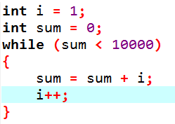
TUIT
Check Point
Can you always convert a while loop into a for loop? Convert the following while loop into a for loop.

Slide 7
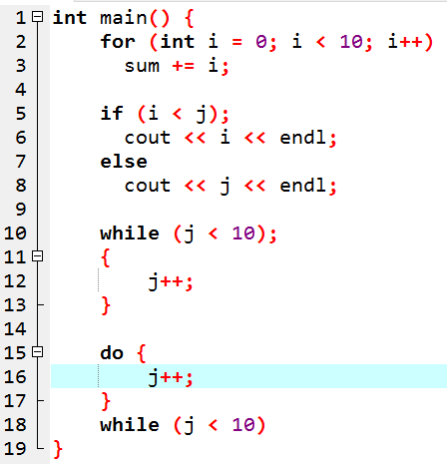
TUIT
Check Point
Identify and fix the errors in the following code:

Slide 8
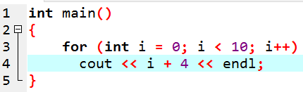
TUIT
Check Point
What is wrong with the following programs?

Slide 9
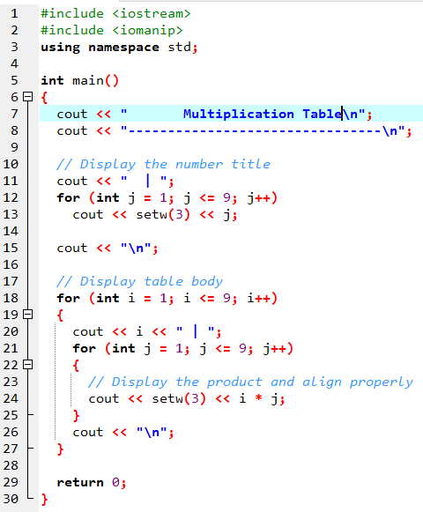

TUIT
Nested Loops
Multiplication Table -------------------------------- | 1 2 3 4 5 6 7 8 9 1 | 1 2 3 4 5 6 7 8 9 2 | 2 4 6 8 10 12 14 16 18 3 | 3 6 9 12 15 18 21 24 27 4 | 4 8 12 16 20 24 28 32 36 5 | 5 10 15 20 25 30 35 40 45 6 | 6 12 18 24 30 36 42 48 54 7 | 7 14 21 28 35 42 49 56 63 8 | 8 16 24 32 40 48 56 64 72 9 | 9 18 27 36 45 54 63 72 81

Slide 10
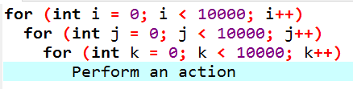
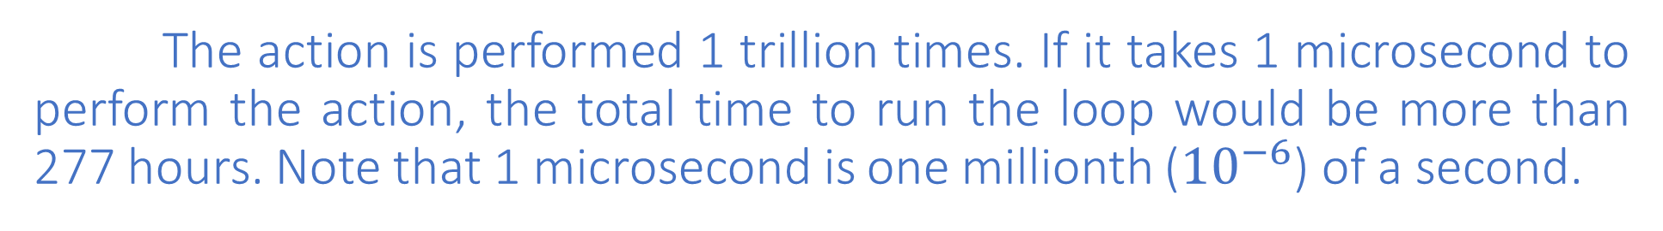
TUIT
Note
Be aware that a nested loop may take a long time to run. Consider the following loop nested in three levels:
The action is performed 1 trillion times. If it takes 1 microsecond to perform the action, the total time to run the loop would be more than 277 hours. Note that 1 microsecond is one millionth (${10}^{−6}$) of a second.

Slide 11
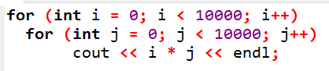
TUIT
Check Point
How many times is the print statement executed?

Slide 12
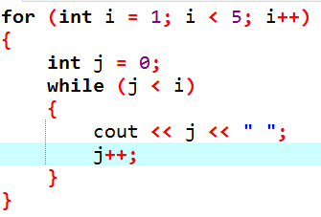
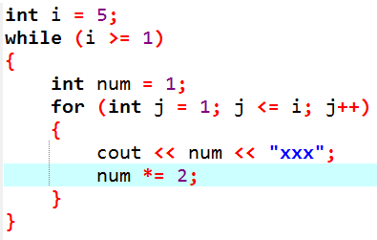
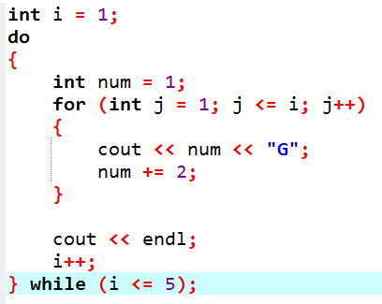
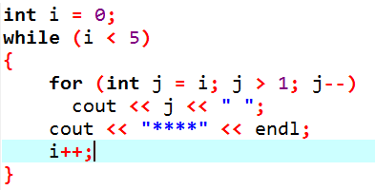
TUIT
Check Point
Show the output of the following programs. (Tip: Draw a table and list the variables in the columns to trace these programs.)

Slide 13
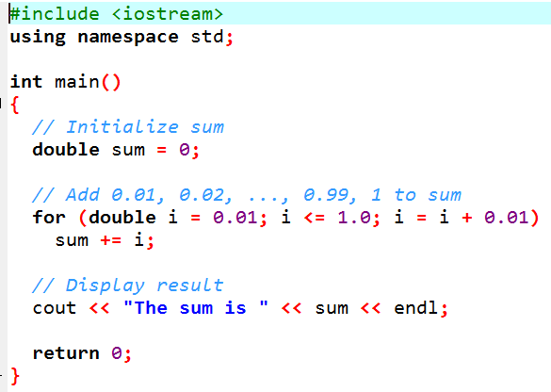
TUIT
Minimizing Numeric Errors
Using floating-point numbers in the loop continuation condition may cause numeric errors
The sum is 49.5
The result is 49.5, but the correct result should be 50.5.

Slide 14
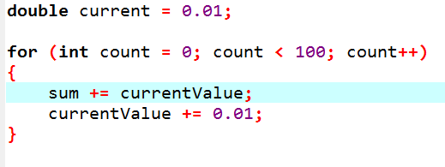
TUIT
Minimizing Numeric Errors
To fix the problem, use an integer count to ensure that all the numbers are added to sum. Here is the new loop:
After this loop, sum is 50.5

Slide 15
TUIT
Case Studies
Loops are fundamental in programming. The ability to write loops is essential in learning programming.
If you can write programs using loops, you know how to program! For this reason, this section presents four additional examples of solving problems using loops.

Slide 16
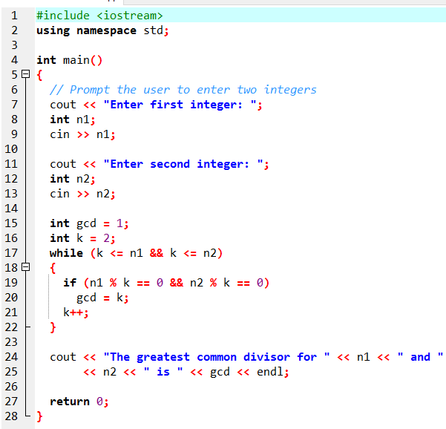

TUIT
Case Study: Finding the Greatest Common Divisor
Enter first integer: 125 Enter second integer: 2525 The greatest common divisor for 125 and 2525 is 25

Slide 17
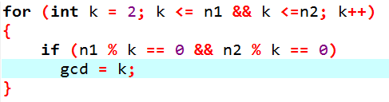
TUIT
Case Study: Finding the Greatest Common Divisor
You could use a for loop to rewrite the code as follows:

Slide 18
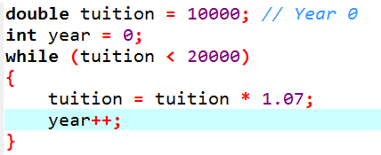
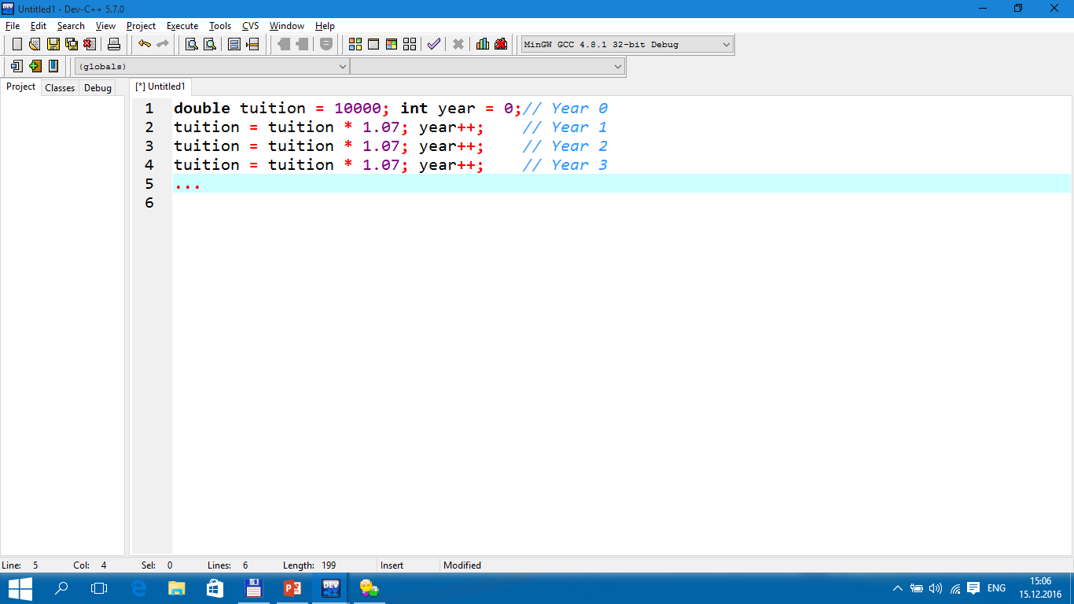
TUIT
Case Study: Predicting the Future Tuition
Suppose that the tuition for a university is $10,000 this year and tuition increases 7% every year. In how many years will the tuition be doubled?

Slide 19
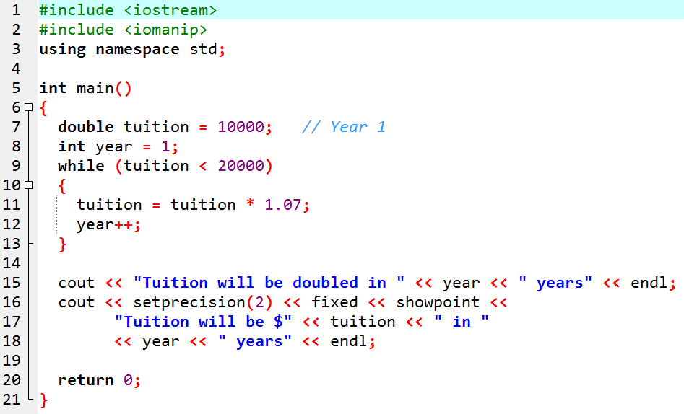
TUIT
Case Study: Predicting the Future Tuition
Tuition will be doubled in 11 years Tuition will be $21048.52 in 11 years

Slide 20
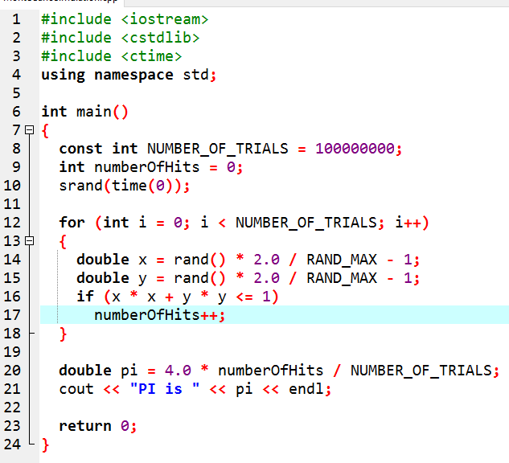
TUIT
Case Study: Monte Carlo Simulation
PI is 3.14124

Slide 21
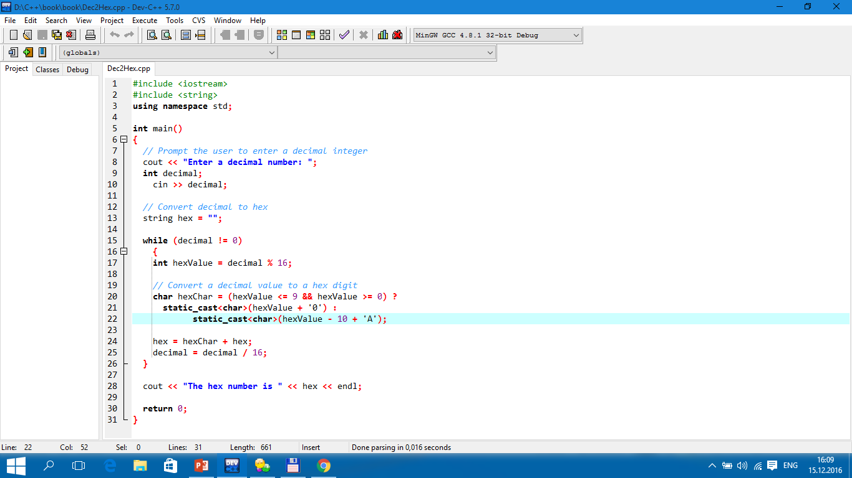
TUIT
Case Study: Converting Decimals to Hexadecimals
Enter a decimal number: 1234 The hex number is 4D2

Slide 22
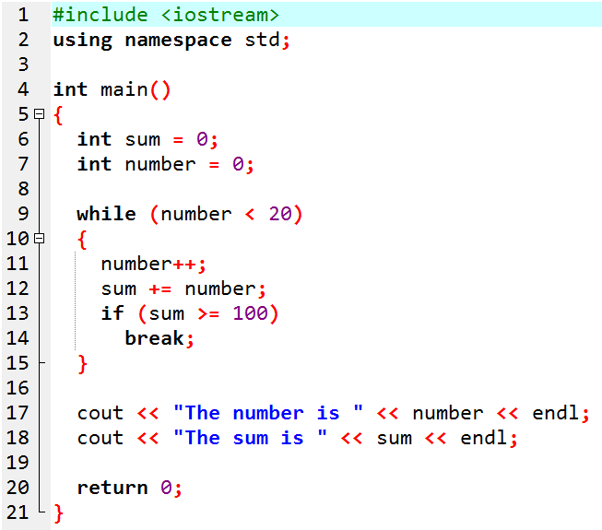
TUIT
Keywords break and continue
The break and continue keywords provide additional controls in a loop.
The number is 14 The sum is 105
Without lines 13-14, the output would be
The number is 20 The sum is 210

Slide 23
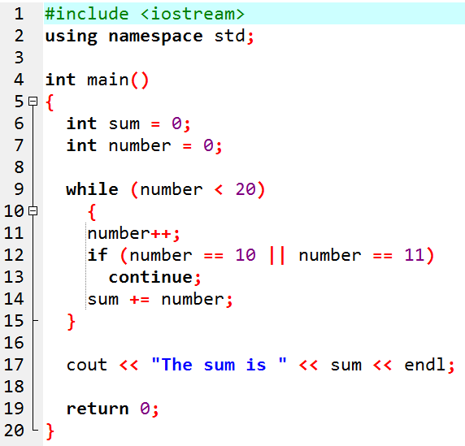
TUIT
Keywords break and continue
You can also use the continue keyword in a loop.
The sum is 189
Without lines 12-13, the output would be as follows:
The sum is 210

Slide 24
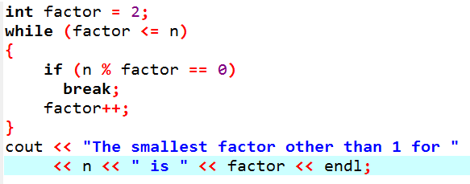
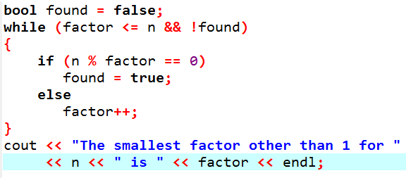
TUIT
Keywords break and continue
Suppose you need to write a program to find the smallest factor other than 1 for an integer n (assume n >= 2). You can write a simple and intuitive code using the break statement as follows:
Too many break and continue statements will produce a loop with many exit points and make the program difficult to read.

Slide 25
TUIT
Note
Some programming languages including C++ have a goto statement indiscriminately transfers control to any statement in the program and executes it. This makes your program vulnerable to errors. The break and continue statements in C++ are different from goto statements.

Slide 26
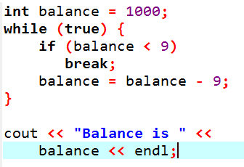
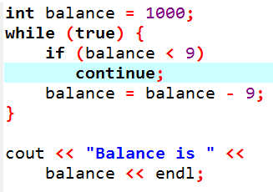
TUIT
Check Point
What is the keyword break for? What is the continue for? Will the following programs terminate? If so, give the output.

Slide 27
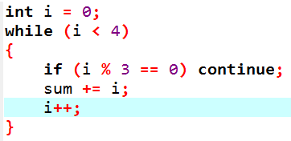
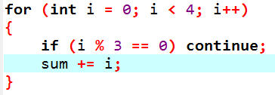
TUIT
Check Point
The for loop on the left is converted into the while loop on the right. What is wrong? Correct it
Converted
Wrong
conversation

Slide 28
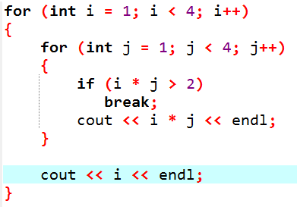
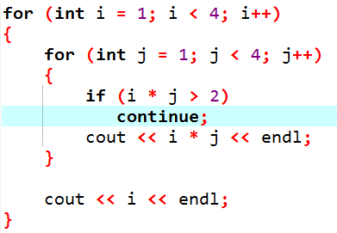
TUIT
Check Point
After the break statement in (a) is executed in the following loop, which statement is executed? Show the output. After the continue statement in (b) is executed in the following loop, which statement is executed? Show the output.
(a)
(b)

Slide 29
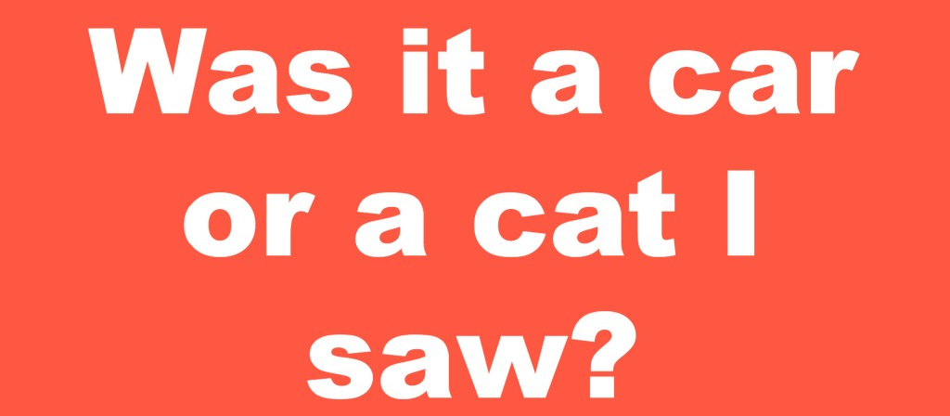
TUIT
Case Study: Checking Palindromes
This section presents a program that tests whether a string is a palindrome. A string is a palindrome if it reads the same forward and backward. The words “mom”, “dad”, and “noon”, for example, are palindromes.

Slide 30
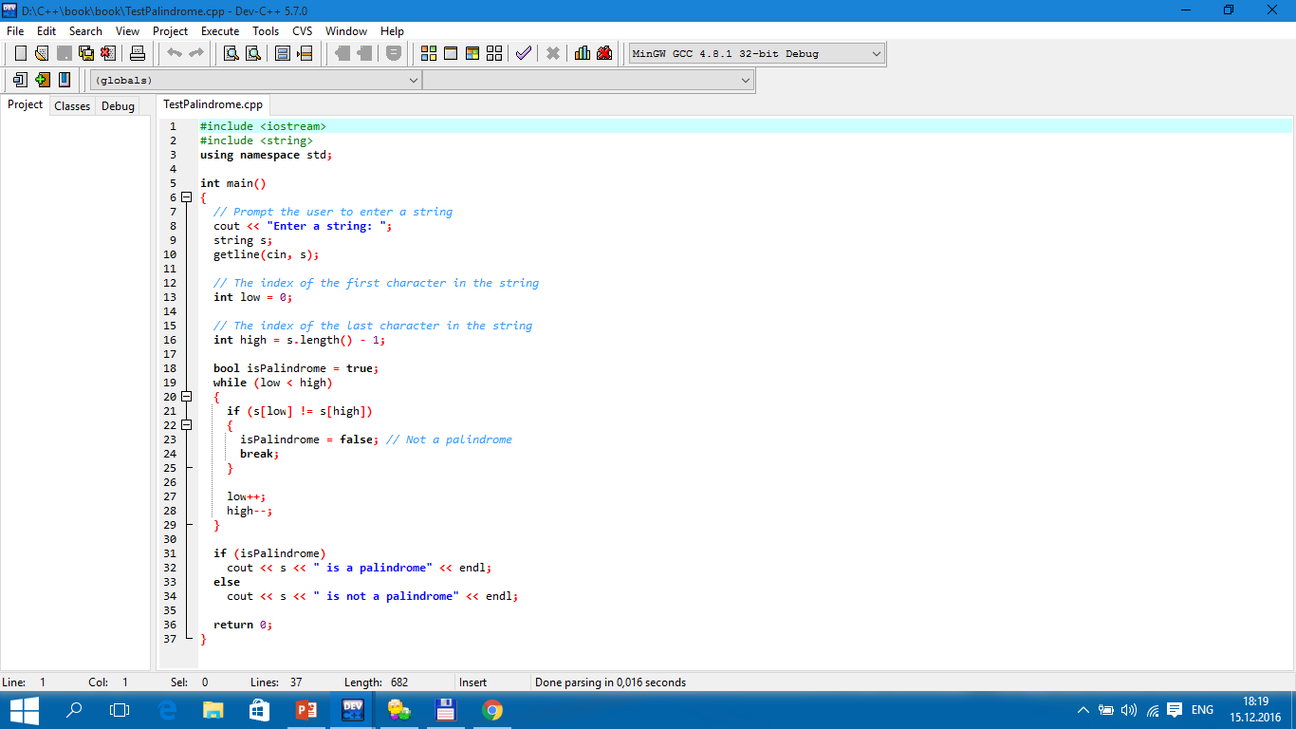
TUIT
Case Study: Checking Palindromes
Enter a string: abccba abccba is a palindrome
Enter a string: abca abca is not a palindrome

Slide 31
TUIT
Case Study: Displaying Prime Numbers
This section presents a program that displays the first 50 prime numbers in 5 lines each containing 10 numbers.
An integer greater than 1 is prime if its only positive divisor is 1 or itself. For example, 2, 3, 4, and 7 are prime numbers, but 4, 6, 8, and 9 are not. The program can be broken into the following tasks:
Determine whether a given number is prime.
For number = 2, 3, 4, 5, 6, … , test whether it is prime.
Count the prime numbers.
Display each prime number, and display ten numbers per line.

Slide 32
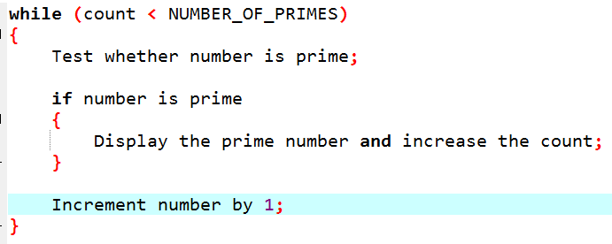
TUIT
Case Study: Displaying Prime Numbers
Here is the algorithm:
Set the number of prime numbers to be printed as a constant NUMBER_OF_PRIMES;
Use count to track the number of prime numbers and set an initial count to 0;
Set an initial number to 2;

Slide 33
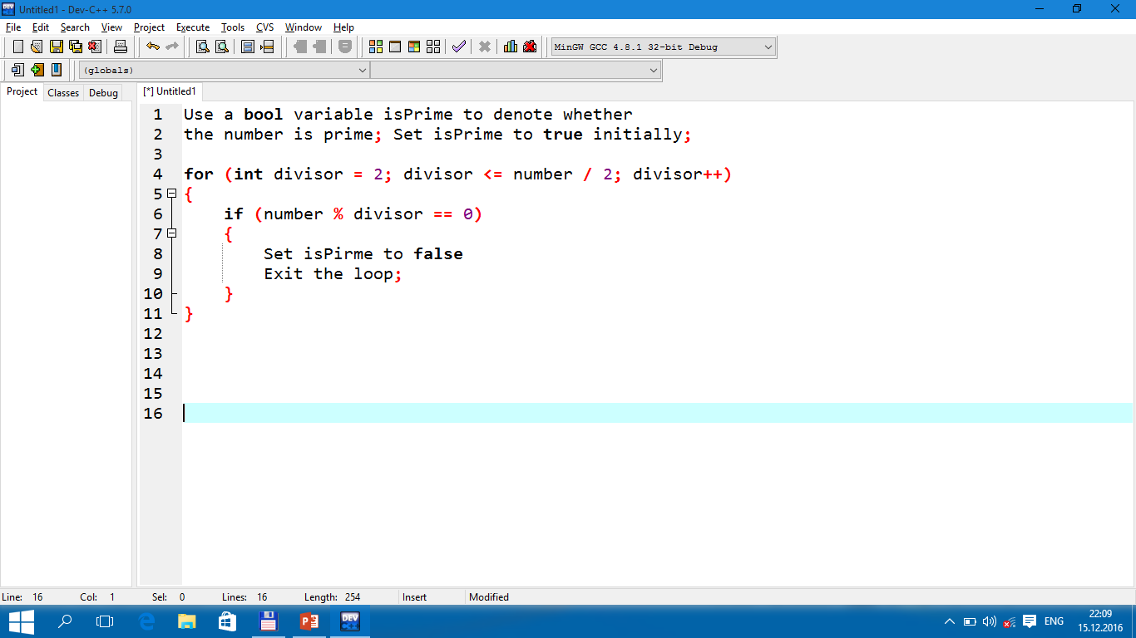
TUIT
Case Study: Displaying Prime Numbers
To test whether a number is prime, check whether it is divisible by 2, 3, 4, up to number/2. If a divisor is found, the number is not a prime. The algorithm can be described as follows:

Slide 34
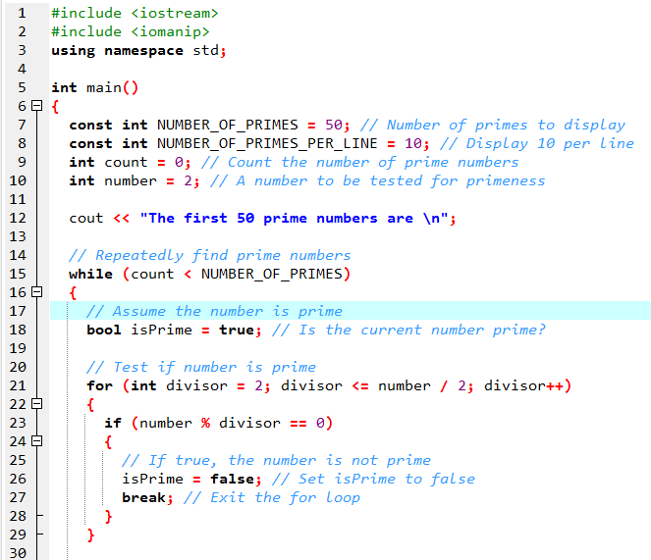
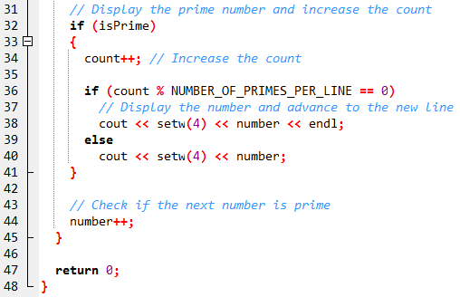
TUIT
Case Study: Displaying Prime Numbers
The first 50 prime numbers are 2 3 5 7 11 13 17 19 23 29 31 37 41 43 47 53 59 61 67 71 73 79 83 89 97 101 103 107 109 113 127 131 137 139 149 151 157 163 167 173 179 181 191 193 197 199 211 223 227 229

Slide 35
TUIT
Summary
The do-while loop is similar to the while loop, expect that the do-while loop executes the loop body first and then checks the loop-continuation-condition to decide whether to continue or to terminate.
The while loop and the do-while loop often are used when the number of repetitions is not predetermined.
A sentinel value is a special value that signifies the end of the loop.
The for loop generally is used to execute a loop body a fixed number of times.
The while loop and for loop are called pretest loops because the continuation condition is checked before the loop body is executed.
Two keywords, break and continue, can be used in a loop.
The break keyword immediately ends the innermost loop, which contains the break. The continue keyword only ends the current iteration.

